Slide 1
Graph-Based Stance Grouping in Multi-Participant Discussions
Paper ID - 270
1. Lamim Zakir Pronay, Department of Computer Science Engineering , National Institute of Technology Andhra Pradesh,
Tadepalligudem - 534101 , Andhra Pradesh , India, 420154@student.nitandhra.ac.in
2. Mohan koruprolu, Department of Computer Science Engineering , National Institute of Technology Andhra Pradesh,
Tadepalligudem - 534101 , Andhra Pradesh , India, 420151@student.nitandhra.ac.in
3. Mediboyina Rupesh Kumar Yadav , Centre of Studies in Resources Engineering (CSRE) , Indian Institute of Technology
Bombay , IIT Area, Powai-400076 , Maharashtra , India, 24m0319@iitb.ac.in
4. Venna Nithin Krishna , Department of Computer Science Engineering , National Institute of Technology Andhra Pradesh,
Tadepalligudem - 534101 , Andhra Pradesh , India, 420251@student.nitandhra.ac.in
5. Sathvik Narala , Department of Computer Science Engineering , National Institute of Technology Andhra Pradesh,
Tadepalligudem - 534101 , Andhra Pradesh , India, 420232@student.nitandhra.ac.in
6. Moola Vishwachandra Rajender, Department of Computer Science Engineering , National Institute of Technology Andhra
Pradesh, Tadepalligudem - 534101 , Andhra Pradesh , India, 420210@student.nitandhra.ac.in

Slide 2

Problem Definition
Stance Detection

Slide 3


The Challange
CHALLANGE
Using the text to decide the stance can be misleading

Slide 4

DISPUTE
CLARIFY
SUPPORT

Slide 5


Slide 6
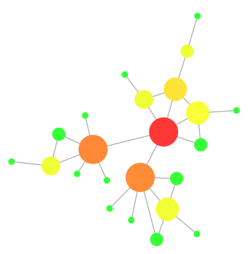



Orginal Post
Reply
Reply
Reply
Reply
Reply
Reply

Slide 7
KEY ASSUMPTION
Key Assumptions
If A replies to B then A and B hold opposite stance

Slide 8

Interaction Graph

Slide 9
Our Heat Diffusion Approach
Algorithm Overview
Initialization:
Stance of each node starts at 0.0.
Nodes with zero in-degree are set to 1.0.
Iterative Update:
For each node, the stance is updated based on weighted sum of neighbors' stances.
Alpha hyperparameter controls the weighting between neighbor influence and current stance.
Weighted Sum:
The stance update is based on the weighted sum of neighbors' stances.
Formula: new_stance = α * (weighted sum of neighbors) + (1 - α) * current_stance
Purpose: Adjust the stance of each node iteratively until convergence.

Slide 10
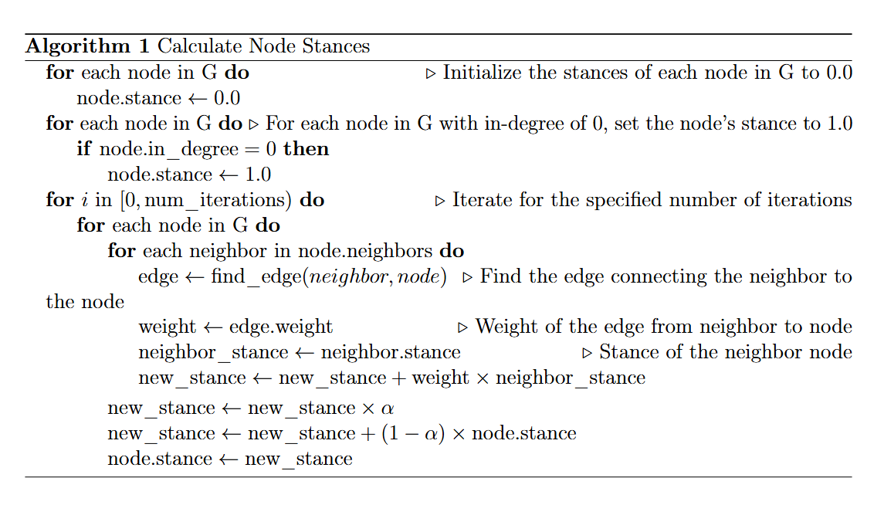

Slide 11
Hyperparameter Tuning
Alpha (α):
Influences the weight of neighbor stances in the update process.
Optimal α is determined via random search or grid search.
Threshold:
Defines the boundary between positive and negative stances.
Can be adjusted for trade-off between precision and recall.
Random Search for Hyperparameter Tuning
Process:
Randomly sample alpha and threshold values.
Evaluate performance using F1 score.
Store best-performing combinations for optimal hyperparameters.
Goal: Find the alpha and threshold that maximize the F1 score.

Slide 12
Advantages of the Heat Diffusion Approach
Local Relationship Utilization:
Captures fine-grained interactions between nodes and their neighbors.
Provides a more nuanced understanding of stance dynamics.
Effective in Diverse Networks:
Better for datasets with strong local connections (e.g., authors and posts).
Comparison to Structural Embedding Approaches
Structural Embeddings:
Focus on global graph structure and node relationships.
May overlook local dynamics.
Heat Diffusion:
More efficient in capturing local interactions and nuanced stances.
Performs better in sparse or complex graphs.

Slide 13
Strengths and Applications
Strengths:
Efficient for large graphs with local structure.
Flexibility in adapting to different tasks (node classification, link prediction).
Applications:
Opinion mining, sentiment analysis, social media analytics.
Can be extended to other domains and languages.
Conclusion and Future Work
Summary:
The heat diffusion algorithm effectively propagates stances across networks.
Hyperparameter tuning plays a critical role in achieving high accuracy.
Future Directions:
Explore scalability and adaptability to more diverse datasets.
Further improvements in tuning methods (e.g., automated optimization).

